Slide 1


Design And Development of Drinking Water Quality alert System With Voice Announcement for Remote Areas
BY
2211CS050001 - Haresh kumar
2211CS050015 -Bharath kumar
2211CS050028 - Ganga Reddy
Under the guidance of
Dr. ome neralla
Assistant Professor
Department of Internet of Things(IOT)
School of Engineering
Malla Reddy University
Hyderabad, Telangana, INDIA

Slide 2
Contents :
i Abstract
Introduction
System Analysis
Architectural Design
Implementation
Results
Conclusion

Slide 3
i. Abstract:
Ensuring safe drinking water is a critical public health requirement due to increasing water pollution and contamination. Conventional water quality testing methods are manual, time-consuming, and do not provide real-time information. This project presents an Development of Drinking Water Quality Monitoring and Alert System that enables continuous and real-time monitoring of water quality parameters. The system uses various sensors to measure essential parameters such as pH, turbidity, total dissolved solids (TDS), and temperature of drinking water. These sensors are interfaced with a Wi-Fi enabled microcontroller, which collects and transmits the sensor data to a cloud platform for storage and analysis. The monitored values are compared with standard safe drinking water limits, and when abnormal conditions are detected, instant alerts are generated and sent to users or concerned authorities. This system reduces human effort, ensures timely detection of water contamination, and helps in preventing water-borne diseases. The proposed solution is cost-effective, scalable, and suitable for smart city and rural water supply applications

Slide 4
1.Introduction:
1.1 Problem Definition & Description:
Access to safe and clean drinking water is a fundamental requirement for human health, yet water contamination remains a serious issue due to industrial waste, sewage leakage, agricultural runoff, and natural impurities.
Traditional water quality monitoring methods depend on manual sample collection and laboratory testing, which are time-consuming, expensive, and do not provide real-time results. Because of this delay, contamination is often detected only after people have already consumed unsafe water.
In many urban and rural areas, drinking water is supplied without continuous quality monitoring. Important parameters such as pH, turbidity, total dissolved solids (TDS), and temperature can vary suddenly, but the absence of an automated monitoring and alert system prevents timely detection and response.

Slide 5
1.2 Objective of the Project:
The objective of this project is to design and develop an IoT based drinking water quality monitoring and alert system that continuously monitors the quality of drinking water in real time.
The system aims to measure important water quality parameters such as pH, turbidity, total dissolved solids (TDS), and temperature using suitable sensors.
It focuses on detecting water contamination at an early stage by comparing the measured values with standard safe drinking water limits.

Slide 6
1.3 Scope of the Project:
The scope of the IoT Based Drinking Water Quality Monitoring and Alert System includes the continuous and real-time monitoring of drinking water quality using IoT technology.
The project focuses on measuring essential water quality parameters such as pH, turbidity, total dissolved solids (TDS), and temperature to assess the safety of drinking water.
It enables remote data transmission to a cloud platform, allowing users and authorities to monitor water quality from any location.
The system also provides automatic alert notifications when water quality parameters exceed permissible limits, ensuring timely action.
The project is designed to be cost-effective and scalable, making it suitable for applications such as municipal water supply systems, rural drinking water sources, smart cities, and water treatment plants.

Slide 7
2. System Analysis
System analysis involves a detailed study of the existing system, identification of its limitations, and defining the requirements of the proposed system.
These methods are time-consuming, labor-intensive, costly, and do not provide real-time information. Due to the lack of continuous monitoring and instant alerts, contamination is often detected late, increasing health risks.
The system uses water quality sensors to continuously monitor parameters such as pH, turbidity, TDS, and temperature. A microcontroller processes the sensor data and transmits it to a cloud platform through the internet.
The cloud system stores and analyzes the data by comparing it with standard safe limits. If any parameter exceeds the permissible range, the system immediately generates alerts to notify users or concerned authorities.

Slide 8
2.1 Existing System:
2.1.1 Background & Literature Survey:
Water quality monitoring is essential to ensure safe drinking water, as contamination caused by industrial waste, sewage, and agricultural activities poses serious health risks.
Traditional water testing methods rely on manual sample collection and laboratory analysis, which are time-consuming and unsuitable for real-time monitoring.
To overcome these limitations, researchers have proposed sensor-based and IoT-enabled water quality monitoring systems. These systems use sensors to measure parameters such as pH, turbidity, TDS, and temperature, and transmit data to cloud platforms for remote monitoring.
However, existing solutions often face challenges such as high cost, limited scalability, and maintenance issues. Hence, there is a need for a cost-effective and reliable IoT-based water quality monitoring and alert system for continuous and real-time monitoring.

Slide 9
2.1.2 Limitations of Existing System:
The existing drinking water quality monitoring system mainly relies on manual sample collection and laboratory testing, which is time-consuming and labor-intensive.
It does not provide real-time or continuous monitoring, making it difficult to detect sudden contamination.
The process is costly and requires skilled manpower and specialized equipment. There is no automatic alert mechanism to immediately inform users or authorities when water quality becomes unsafe.
Additionally, the existing system lacks remote monitoring and data storage capabilities, which limits timely decision-making and effective water quality management.

Slide 10
2.2 Proposed System:
The proposed system uses multiple water quality sensors to measure important parameters such as pH, turbidity, total dissolved solids (TDS), and temperature.
These sensors are connected to a Wi-Fi enabled microcontroller, which collects and processes the sensor data.
The measured data is transmitted to a cloud platform through the internet, where it is stored and analyzed by comparing it with standard safe drinking water limits.
When any parameter exceeds the permissible range, the system automatically generates alerts and notifies users or concerned authorities through voice announcements or dashboards.
The proposed system reduces human intervention, enables remote monitoring, provides quick detection of contamination, and ensures timely action.

Slide 11
Literature Survey Links:
Konde, S., & Deosarkar, S. (2020). IoT-based water quality monitoring system. International Journal of Engineering and Technology
Sugapriyaa, T., Rakshaya, S., Ramyadevi, K., Ramya, M., & Rashmi, P. G. (2018). Smart water quality monitoring system for real-time applications. International Journal of Engineering & Technology
Unnikrishna Menon, K. A., Ramesh, M. V., & D. P. (2012). Wireless sensor network for river water quality monitoring in India. International Journal of Computer Applications
Kumar, M. J. V., & Samalla, K. (2019). Design and development of water quality monitoring system in IoT. International Journal of Engineering and Technology
Hamid, S. A., Rahim, A. M. A., Fadhlullah, S. Y., Abdullah, S., Muhammad, Z., & Leh, N. A. M. (2020). IoT-based water quality monitoring system and evaluation.

Slide 12
2.3 Software & Hardware Requirements:
2.3.1 Software Requirements:
Operating System: Windows
Programming Language: Arduino Programming
Development Environment: Arduino IDE
Cloud Platform: ThingSpeak / Blynk
Database: Cloud-based database
Web Browser: Google chrome
Communication Protocol: HTTP / MQTT
Internet Connection: Required for data transmission and alert generation
2.3.2 Hardware Requirements:
Microcontroller
pH Sensor
Turbidity Sensor
TDS Sensor
Voice Speaker
WiFi Module
Breadboard
Jumper Wires
Power Supply

Slide 13
2.4 Feasibility Study:
2.4.1 Technical Feasibility:
The system is built using commonly used microcontrollers such as ESP8266 or Arduino, along with standard water quality sensors like pH, turbidity, TDS, and temperature sensors.
The required software tools such as Arduino IDE and cloud platforms like Thing Speak or Firebase are reliable, user-friendly, and well-supported.
Wireless data transmission through Wi-Fi ensures real-time monitoring and remote access to water quality data.
The system does not require complex hardware or advanced infrastructure, making it easy to design, implement, and maintain.
Hence, from a technical perspective, the project is practical, reliable, and achievable within the available resources and technical skills.

Slide 14
2.4.2 Robustness & Reliability:
The proposed system is robust and reliable as it uses standard and durable sensors along with a stable microcontroller for continuous operation. Sensor data is regularly transmitted and stored on a cloud platform, ensuring data safety and consistency.
The alert mechanism provides immediate notification in case of abnormal water quality, enabling timely action. The modular design and periodic sensor calibration further improve the reliability and long-term performance of the system
2.4.3 Economic Feasibility:
The proposed IoT based drinking water quality monitoring and alert system is economically feasible as it uses low-cost and easily available hardware components such as sensors and microcontrollers.
Open-source software tools and free or low-cost cloud platforms are used, which reduces development and maintenance costs. The system minimizes manual labor and frequent laboratory testing, leading to long-term cost savings

Slide 15
3.Architectural Design
3.1 Modules Design
The architectural design of the proposed system consists of multiple layers that work together to monitor and analyze drinking water quality in real time. At the sensing layer, water quality sensors such as pH, turbidity, TDS, and temperature sensors are deployed to continuously measure water parameters.
Sensing Layer
Water quality sensors such as pH, turbidity, TDS, and temperature sensors are placed in the water source. These sensors continuously sense and collect real-time water quality parameters.
Data Acquisition
The sensors are connected to a microcontroller (ESP8266/NodeMCU). The microcontroller reads the analog sensor values and converts them into digital data.
Data Processing
The microcontroller processes the collected sensor data and checks whether the values are within safe drinking water limits.

Slide 16
Communication Layer
Using the built-in Wi-Fi module, the processed data is transmitted to the cloud platform through the internet.
Cloud Storage and Analysis
The cloud platform stores the received data and performs further analysis. The data is visualized in the form of graphs and charts for easy monitoring.
Alert Generation
If any water quality parameter exceeds the permissible limit, the system automatically triggers an alert.
User Interface
Users or authorities can access real-time and historical water quality data through a web or mobile dashboard and take necessary actions..

Slide 17
3.2 Methods and Algorithms:
Methods & Algorithm of IoT Based Drinking Water Quality Monitoring and Alert System
Sensor Data Collection Module
Method:
Measures essential drinking water quality parameters using multiple sensors deployed at the water source.
Algorithm:
System initializes water quality sensors.
Sensors continuously measure pH, turbidity, TDS, and temperature.
Raw sensor readings are sent to the microcontroller.
2. Data Acquisition & Preprocessing Module
Method:
Processes raw sensor signals and converts them into meaningful digital values.
Algorithm:
Microcontroller reads analog sensor signals.
Signals are converted into digital format.
Noise filtering and value normalization are applied.
Preprocessed data is forwarded for analysis.

Slide 18
3. Threshold Comparison & Decision Module
Method:
Determines whether the water quality is safe by comparing sensor values with standard limits.
Algorithm:
Receive processed sensor values.
Compare each parameter with predefined safe drinking water thresholds.
If all values are within limits, mark water as safe.
If any value exceeds limits, mark water as unsafe.
4. Data Transmission to Cloud Module
Method:
Uploads real-time sensor data to the cloud platform using internet connectivity.
Algorithm:
Establish Wi-Fi connection.
Package sensor data in required format.
Transmit data to cloud platform.
Confirm successful data upload.
5. Cloud Storage & Analytics Module
Method:
Stores and analyzes water quality data for real-time and historical monitoring.
Algorithm:
Receive sensor data from microcontroller.
Store data in cloud database.
Generate graphs and visual reports.

Slide 19
6. Alert & Notification Module
Method:
Generates alerts when water quality parameters exceed safe limits.
Algorithm:
Monitor analyzed data continuously.
If unsafe condition detected:
  Trigger alert mechanism.
  Send notification to user/authority.
Log alert details in system.
7. User Interface & Monitoring Module
Method:
Allows users to remotely monitor water quality through a dashboard.
Algorithm:
User logs into dashboard.
Fetch real-time and historical data from cloud.
Display readings in graphical format.
Show alert notifications if present.

Slide 20
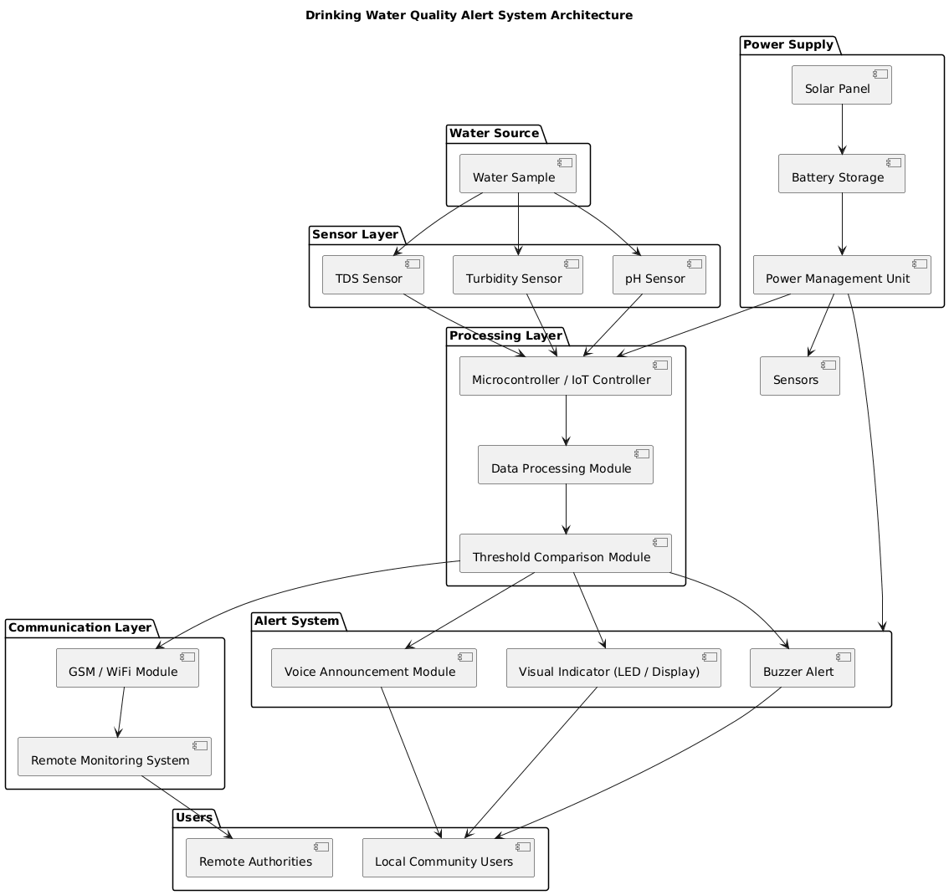
3.3 Project Architecture:
3.3.1 Architecture Diagram:

Slide 21
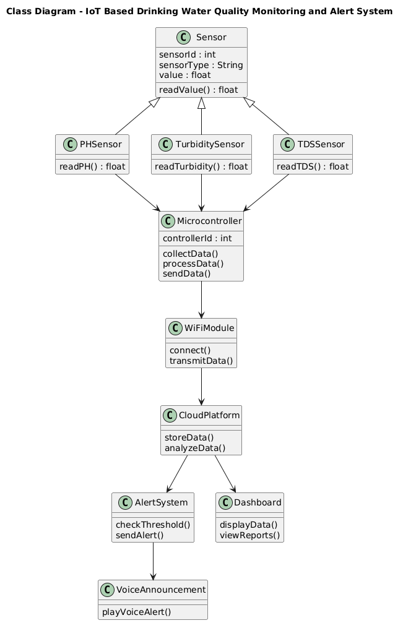
3.2.2 Class Diagram:

Slide 22
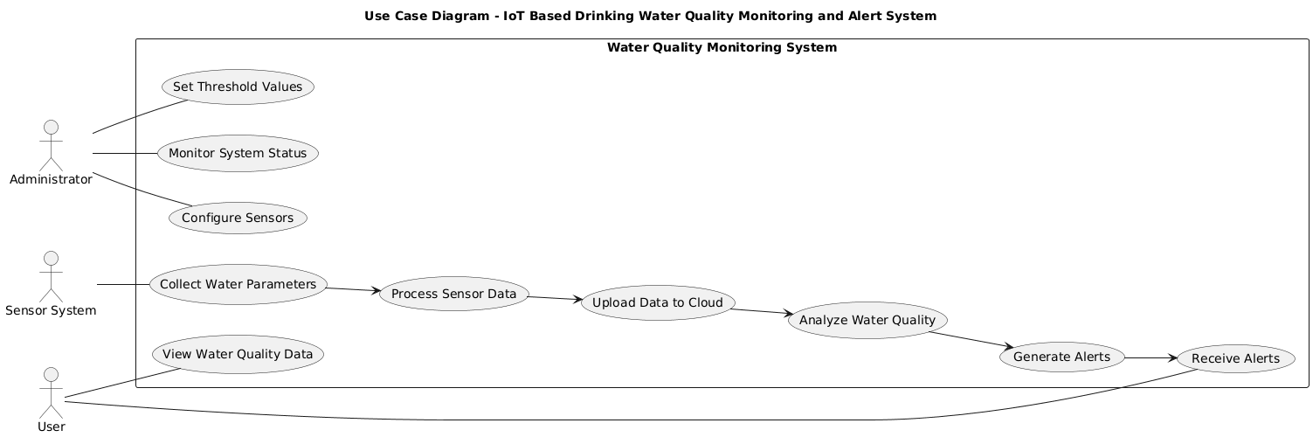
3.2.3 Use Case Diagram:

Slide 23
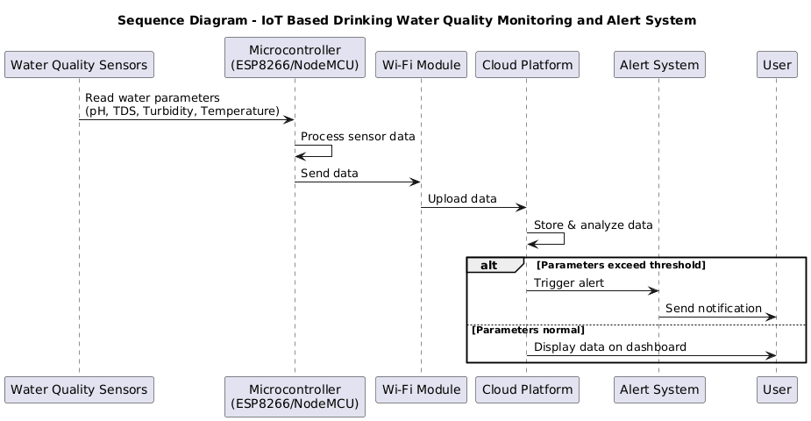
3.2.4 Sequence Diagram:

Slide 24
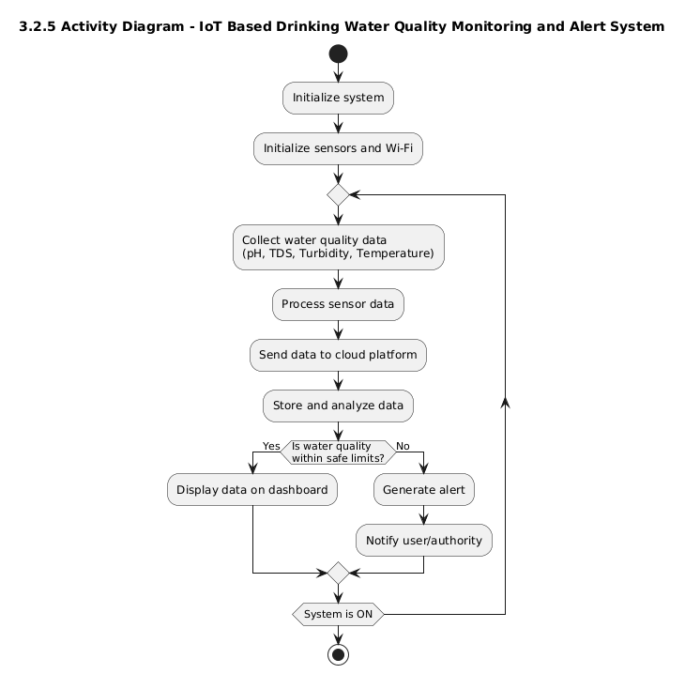
3.2.5 Activity Diagram:

Slide 25
4. Implementation & Testing
#define BLYNK_PRINT Serial
#include <WiFi.h>
#include <BlynkSimpleEsp32.h>
// Blynk Credentials#define BLYNK_TEMPLATE_ID "YOUR_TEMPLATE_ID“
#define BLYNK_DEVICE_NAME "WaterMonitor“
#define BLYNK_AUTH_TOKEN "YOUR_AUTH_TOKEN“
char ssid[] = "YOUR_WIFI";
char pass[] = "YOUR_PASSWORD";
// Pins
#define PH_PIN 34
#define TURB_PIN 35
#define TDS_PIN 32
#define BUZZER_PIN 25
// Safe Limits
float ph_min = 6.5;
float ph_max = 8.5;
float turb_max = 5.0;
float tds_max = 500.0;

Slide 26
BlynkTimer timer;
// Average reading function
float readSensor(int pin) {
long sum = 0;
for (int i = 0; i < 10; i++) {
sum += analogRead(pin);
delay(10);
}
return sum / 10.0;
}
void sendData() {
// Read sensors float phRaw = readSensor(PH_PIN);
float turbRaw = readSensor(TURB_PIN);
float tdsRaw = readSensor(TDS_PIN);
// Convert to voltage
float phVoltage = phRaw * (3.3 / 4095.0);
float turbVoltage = turbRaw * (3.3 / 4095.0);
float tdsVoltage = tdsRaw * (3.3 / 4095.0);

Slide 27
// Conversion formulas (approx)
float pH = 7 + ((2.5 - phVoltage) / 0.18);
float turbidity = (3.3 - turbVoltage) * 100;
float tds = tdsVoltage * 1000;
// Serial Monitor
Serial.println("----- Water Quality -----");
Serial.print("pH: ");
Serial.println(pH);
Serial.print("Turbidity: ");
Serial.println(turbidity);
Serial.print("TDS: ");
Serial.println(tds);
// Send to Blynk
Blynk.virtualWrite(V0, pH);
Blynk.virtualWrite(V1, turbidity);
Blynk.virtualWrite(V2, tds);

Slide 28
// Alert condition
if (pH < ph_min || pH > ph_max || turbidity > turb_max || tds > tds_max) {
digitalWrite(BUZZER_PIN, HIGH); Blynk.virtualWrite(V3, 1);
// LED ON
} else { digitalWrite(BUZZER_PIN, LOW);
Blynk.virtualWrite(V3, 0);
// LED OFF }}
void setup()
Serial.begin(115200);
pinMode(BUZZER_PIN, OUTPUT);
analogReadResolution(12);
Blynk.begin(BLYNK_AUTH_TOKEN, ssid, pass);
// Send data every 5 seconds timer.setInterval(5000L, sendData);
}void loop()
{ Blynk.run();
timer.run();
}

Slide 29
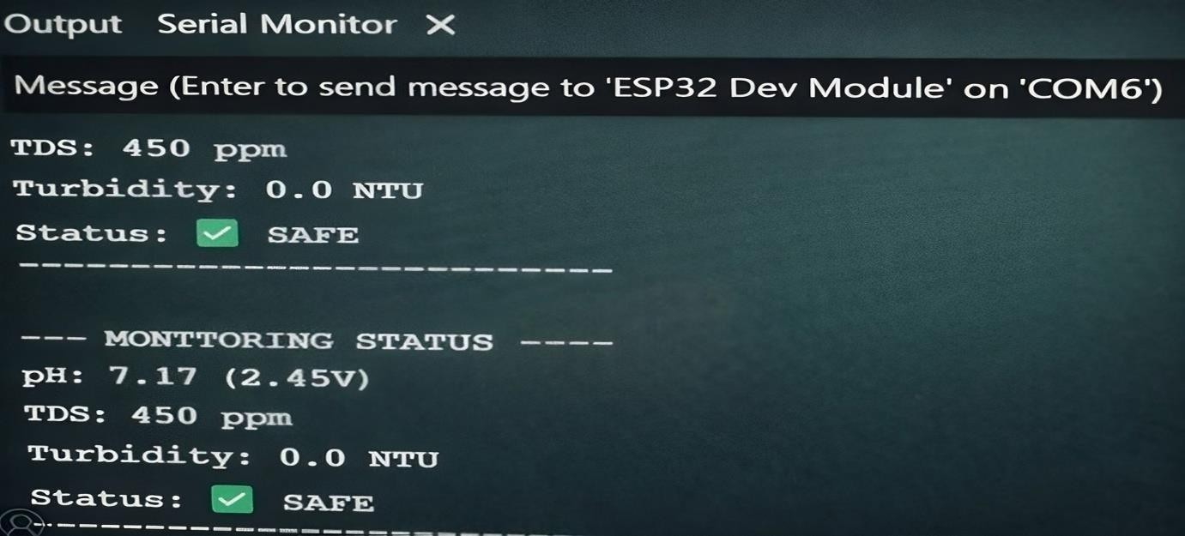
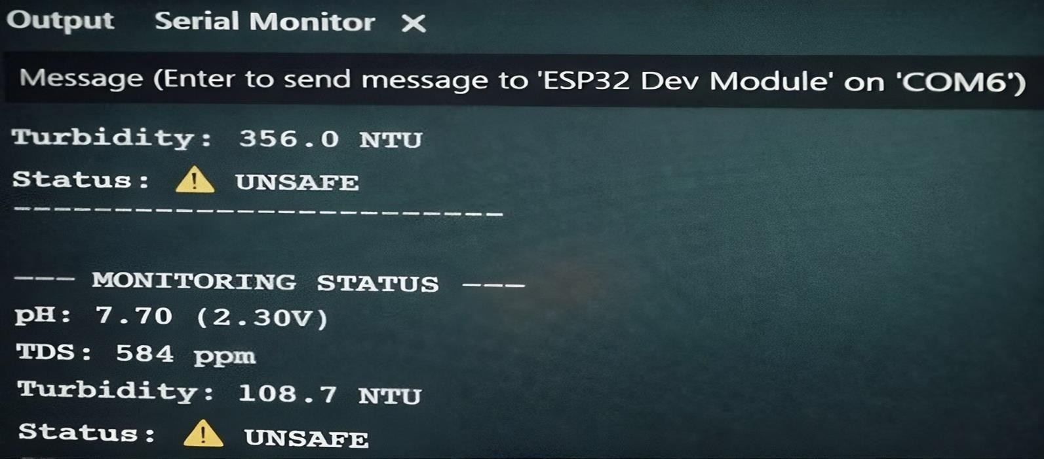
RESULT
Fig No :1- water is safe
Fig No :2- water is unsafe

Slide 30
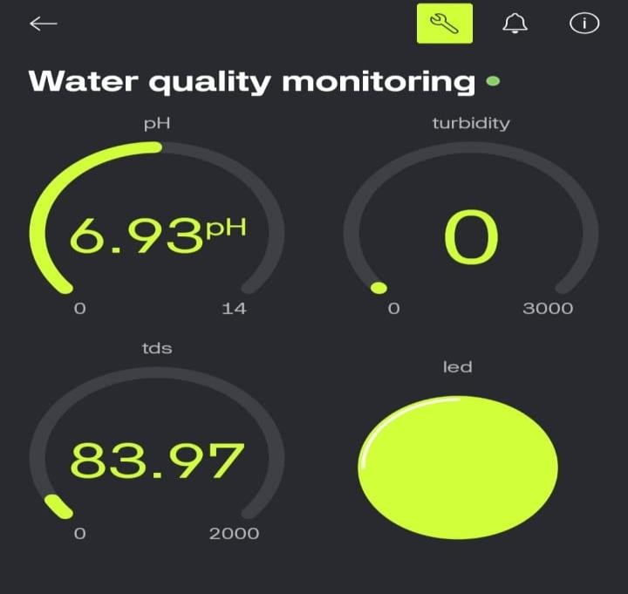
Fig3: Real Time Water Quality Monitoring

Slide 31
Conclusion
In this project, an IoT-Based Drinking Water Quality Monitoring and Alert System with Voice Announcement has been successfully designed and implemented. The system uses sensors such as pH sensor, TDS sensor, and turbidity sensor to continuously monitor important water quality parameters. The collected data is processed by the ESP32 microcontroller, which evaluates whether the water quality falls within safe drinking limits. The system also integrates IoT technology using the Blynk platform, allowing real-time monitoring of water quality through a mobile application or dashboard. Whenever the water quality parameters exceed the predefined safe limits, the system generates alerts using a buzzer and status notification, ensuring that users are immediately informed about unsafe water conditions. The implementation results show that the system can accurately detect both safe and unsafe water conditions and display the results on the serial monitor and IoT dashboard. This system provides a low- cost, efficient, and reliable solution for monitoring drinking water quality, especially in rural and remote areas where regular water testing facilities may not be available. Overall, the developed system helps ensure safe drinking water and supports better health and environmental safety

Slide 32

Thank You

